Slide 1
Consumer Price Index Analysis
Exploring Inflationary Trends Over a Decade (2013–2023)
Presented by : Basantam Sai Rohit

Slide 2
Objective :
“The project aimed to analyze inflation trends using CPI data from 2013 to 2023, identifying price changes across categories and sectors.“
Purpose: To provide actionable insights for businesses, governments, and individuals in adapting to inflationary impacts

Slide 3
Dataset Overview :
Analyzed 10 years of Consumer Price Index (CPI) data (2013–2023).
Key categories: Food, Fuel, Housing, Health, and more.
Focus: Inflation trends across Rural, Urban, and Combined sectors.

Slide 4
Data Analysis Methodology :
Data Preprocessing : Performed data cleaning to fix inconsistencies and missing values.
Visualization : Visualized data trends using Matplotlib, Seaborn, and dynamic charting libraries.
Seasonal Decomposition: Analyzed CPI components to isolate trend, seasonal, and residual influences.
Sectoral Comparison: Compared CPI values across Rural, Urban, and Combined sectors.
Correlation Analysis : Used heatmaps to identify strong correlations between categories like Housing and Transport.

Slide 5
Insights from CPI Analysis :
Consistent rise in CPI over the decade, reflecting long-term inflation trends.
Fuel prices showed the sharpest increase, impacting transportation and energy costs.
Rural and Urban sectors experienced similar inflationary patterns.
Health and Housing sectors demonstrated steady growth, highlighting essential needs inflation.

Slide 6
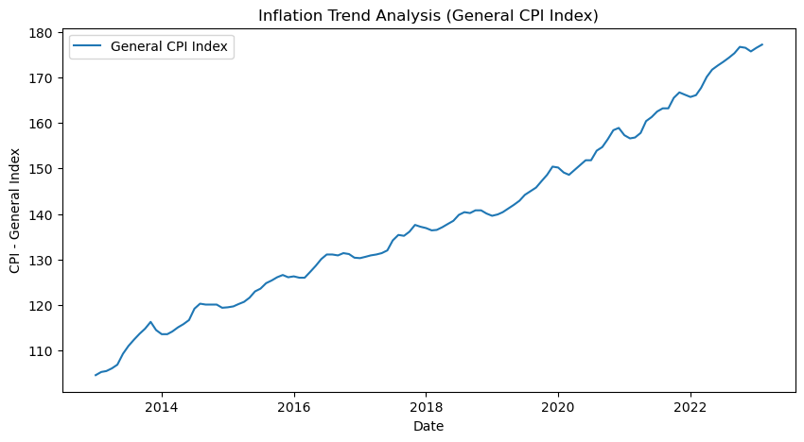
Inflation Trends Over a Decade (2013–2023) :
CPI values increased consistently from 2013 to 2023.
Post-2020 saw sharp inflation, driven by global disruptions.
Reflects rising costs across essential goods and services.

Slide 7
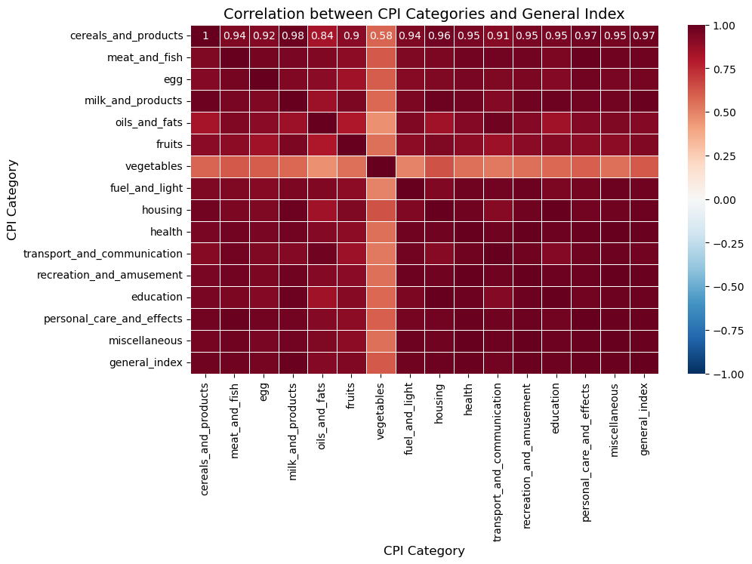
Correlation Between CPI Categories and General Index :
Most categories strongly correlate with the General Index, driving inflation.
Fuel and Housing show the highest correlations, highlighting their impact.
Focused strategies on high-impact sectors can effectively manage inflation

Slide 8
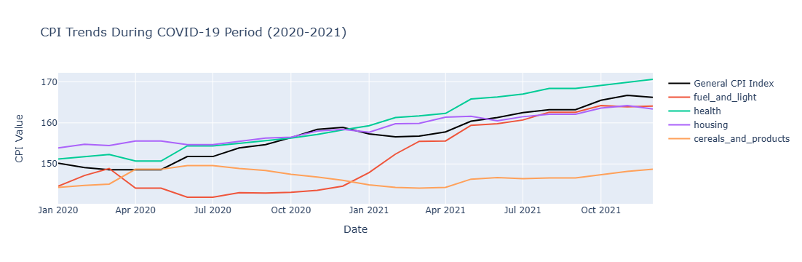
CPI Trends During COVID-19 (2020–2021)
CPI fluctuated significantly during COVID-19, especially in categories like Fuel and Health.
Fuel prices spiked due to supply chain disruptions, while Health costs rose steadily.
These trends reflect the pandemic's impact on essential goods and services

Slide 9
Business Insights :
Fuel price trends impact transportation and energy industries, requiring optimized operations and pricing strategies.
Health sector inflation indicates rising healthcare costs, influencing insurance policies and government budgets.
Uniform inflation across rural and urban areas requires equitable resource allocation and pricing models.

Slide 10
Conclusion :
Significant inflation trends observed over the decade, especially post-2020.
Fuel and Housing sectors faced the steepest increases, impacting businesses and individuals.
Rural and Urban sectors experienced uniform inflation patterns, indicating widespread economic challenges.

Slide 11
Future Scope :
Integrate predictive modeling to forecast CPI trends and inflation impacts.
Expand analysis to include international CPI datasets for cross-country comparisons.
Investigate sector-specific inflation mitigation strategies for targeted policymaking.

